Slide 1
Superior Solar Conjunction Planning
March 21, 2014
Dan Ossing
STEREO Mission Operations Manager
(240) 228-8319

Slide 2
Agenda
Laws of Conjunction
Schedule
Observatory Configuration

Slide 3
Three Laws of STEREO Solar Conjunction
Take all reasonable precautions to keep the observatory safe.
Of course, “reasonable” is subject to interpretation and judgment. We will be guided by the usual risk assessment methodology of weighing both probability and impact, which is, after all, the implicit thinking behind “engineering judgment.”
Return to normal science operations as soon as reasonably possible. In cases where this law conflicts with the First Law, the First Law takes precedence.
There’s that word “reasonably” again. We do not have infinite time and manpower to prepare for conjunction. So, some management judgment is required.
Conduct science operations during conjunction, if reasonably feasible. In cases where this law conflicts with the first two, the first two laws take precedence.
We do not have infinite time and manpower.

Slide 4
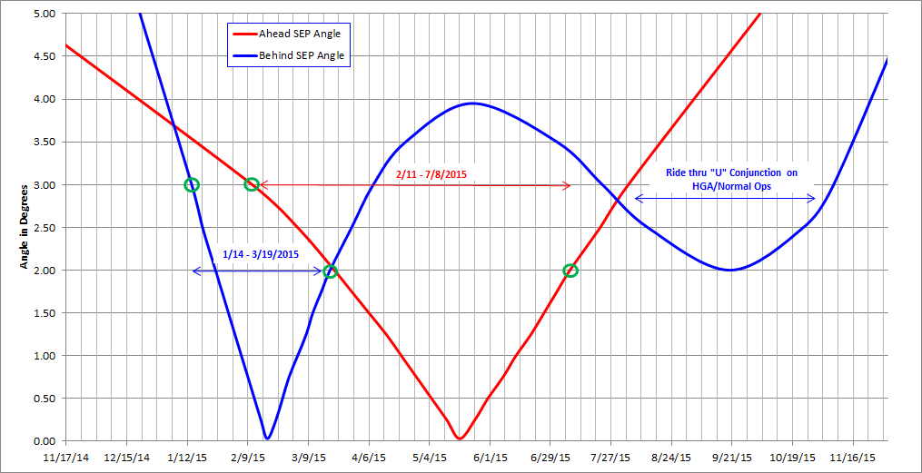
Sun-Earth-Probe (SEP angle) Schedule

Slide 5
Observatory Schedule
Sep 2014 – Test (both) Observatory Solar Conjunction Configuration
Jan 14th - BEHIND – SEP = 3 deg (Feb 11th – AHEAD)
Planned power down of all instruments
Reconfigure SSR for solar conjunction recording
Rehearse observatory entry and exit with DSN
Jan 25th - BEHIND – SEP = 2 deg (Mar 23rd – AHEAD)
Communication link will be suspect
Daily monitoring till loss of communications
Feb 18th - BEHIND – SEP = 0 deg (May 20th – AHEAD)
Observatory flips to keep –Z axis pointed at Earth
Mar 11th - BEHIND – SEP = 1.5 deg (Jun 27th – AHEAD)
MOps begins daily monitoring to establish communications
Playback SSR data & reconfigure SSR for science recording
Mar 19th - BEHIND – SEP = 2 deg (Jul 8th – AHEAD)
Begin powering and reconfiguring of all instruments

Slide 6
STEREO BEHIND Range and Angles

Slide 7
STEREO AHEAD Range and Angles

Slide 8
Observatory Configuration During Solar Conjunction
72-hour reset sequence – hard command loss timer
All instruments powered off, cannot change
Reboot of C&DH, G&C, PDU, transponder, etc.
SSR will retain data across resets
IMUs remain off (fault protection can power on if needed)
Throwing EA Bypass switch to enable use of HGA and reduced gyro operations
C&DH and G&C FSW in use (as it has been since launch)
Telemetry downlinked via the LGAs cannot be received at 2 AU, even with 70m dish
Observatory rotating, at 5 deg/min, about the Sun line
Allows for momentum buildup to be distributed evenly thereby reducing likelihood of autonomous momentum dumps
Instrument operations are possible subject to severe constraints:
C&DH can only issue power-switching commands (& shutdown warning command)
No configuration commands, no code-patching commands, and no stored command buffer usage
Interface heaters on if instrument is off
SSR will record sufficient housekeeping data to reconstruct instrument interface thermal performance

Slide 9
Observatory Configuration Exiting Solar Conjunction
At SEP = 1.5 deg, autonomy rule will stop observatory rotation and point HGA at Earth
Daily 5 hour 70m DSN tracks
For solar scintillation effects, RF performance has been shown to be better using higher data rates (> 10 kbps)
Receipt of one command will reset hard command loss timer to zero.
Need one command received every 72 hours to prevent further resets.
Playback SSR and reconfigure for science operations
Once command link is stable, begin powering on instruments

